Slide 1
Enterprise Pointe
Public Hearing
June 8, 2015
Primary Development Plan
Rezoning Petition REZ-2015-0022

Slide 2
Introduction

Slide 3
Presentation Overview
Development Proposal
Development Partners
Project details
BACKGROUND ON THE APPLICANT
Site Renderings
Requirements of Participation
Business Development
Funding
Timeline
Summary of Written Commitment
Summary of Neighborhood Meetings
Development Issues
Legal Test

Slide 4
Development Proposal
48 apartments for entrepreneurs, business owners, artists, artisans, and makers.
Co-located living and working space, with business amenities on-site.
Located at 800 W Rudisill Blvd, rehabilitation of 3 existing structures, creation of 2 new structures.
Community investment of approximately $7.9 million.

Slide 5
Development Partners

Slide 6
Project Details
48 apartments
(5) one-bedroom
(40) two-bedroom
(3) three-bedroom
Laundry facilities in all buildings
Exercise room
Common space including outdoor garden area, covered outdoor seating, and on-site surface parking.

Slide 7
Project Details
Business Amenities:
Reception Area
3 Private Offices
Conference Room
Mail Room with Copy/Scan/Fax capabilities
Gallery
Studio Space
Multi-Purpose Community Room
Equipment Library
Units with built-in workspace (some with durable finishes/utility sinks)

Slide 8
Project Details
The subject real estate is currently owned by Ambassador Campus Properties, LLC.
Upon approval of the rezoning petition and receipt of tax credit funding for construction of the development, the property will be conveyed to Brightpoint as part of a charitable transaction.
Pursuant to the terms of the agreement between Ambassador and Brightpoint, the property will remain subject to certain use covenants allowing the property to be re-captured by Ambassador in the event that the live-work concept is not fully and finally implemented

Slide 9
Background on the Applicant
Brightpoint is a private, non-profit agency that promotes economic and community development by providing resources, helping people gain access to opportunities, and teaching them the skills they need to be come self sufficient.
This year Brightpoint is celebrating 50 years of activity in the Fort Wayne area, including providing one or more programs to over 35,000 people in 12 counties in northeast Indiana.
Brightpoint was originally founded as the Allen County Economic Opportunity Council in 1965 but later changed its name to Community Action of Northeast Indiana (CANI).

Slide 10
Background on the Applicant
Through a wide range of programs, Brightpoint helps communities, families, and individuals remove the causes and conditions of poverty.
Among its various programs, Brightpoint has previously been involved in residential housing development and redevelopment.
In 2012, Brightpoint and Keller Development completed Hopewell Pointe, a community of 35 single family homes made available to low and moderate income families. All homes are lease-purchase properties, with residents having the opportunity to buy their homes at the end of a 15 year period.

Slide 11
Background on the Applicant
Brightpoint also has been involved in the purchase, rehabilitation and resale of homes to qualifying families. The goal is to make attractive homes available to families and to support the stability of neighborhoods.
Brightpoint also offers small business financing to entrepreneurs and business owners in northeast Indiana. Business development services are also provided to assist with business plan writing, registration, marketing, bookkeeping, and other essential activities.
This is primarily an alternative source of financing for small business owners and entrepreneurs who may otherwise be unable to borrower from traditional lenders due to past credit problems or loan amounts.
Brightpoint regularly works with SCORE, the Indiana Small Business Development Center, Northeast Indiana Innovation Center, and the Fort Wayne Community Development Corporation in connection with its lending programs.

Slide 12
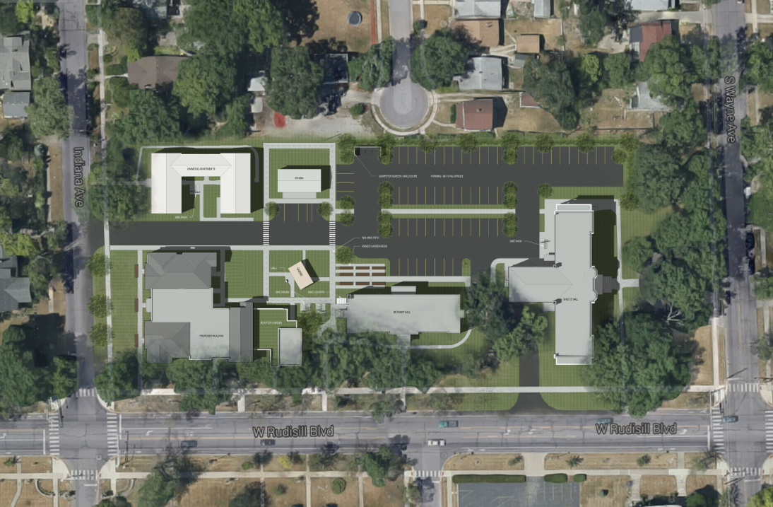

Slide 13
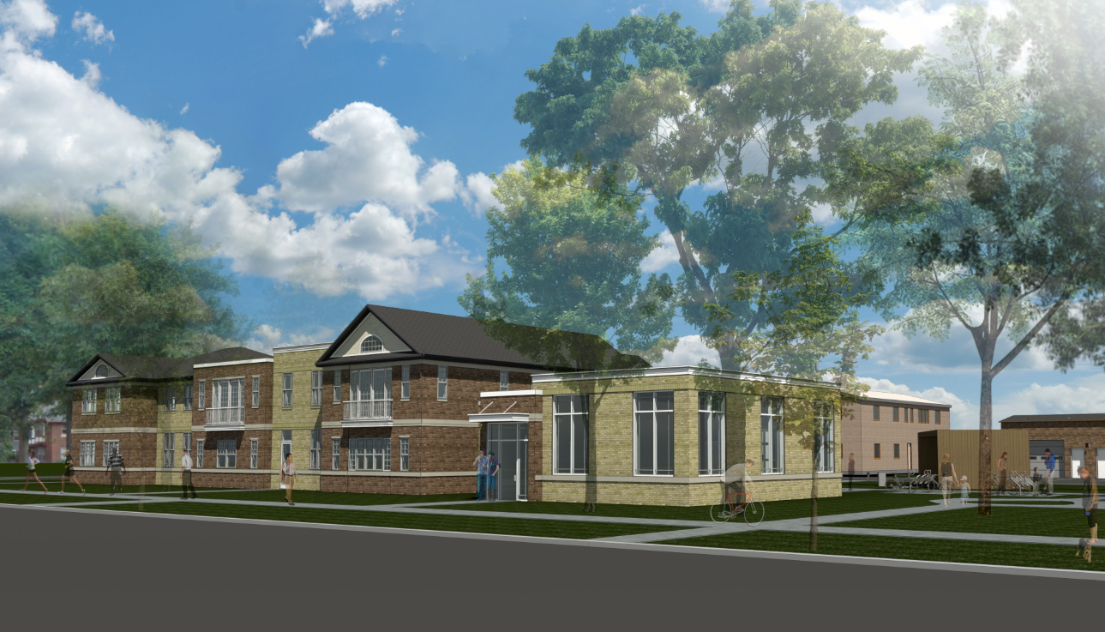

Slide 14
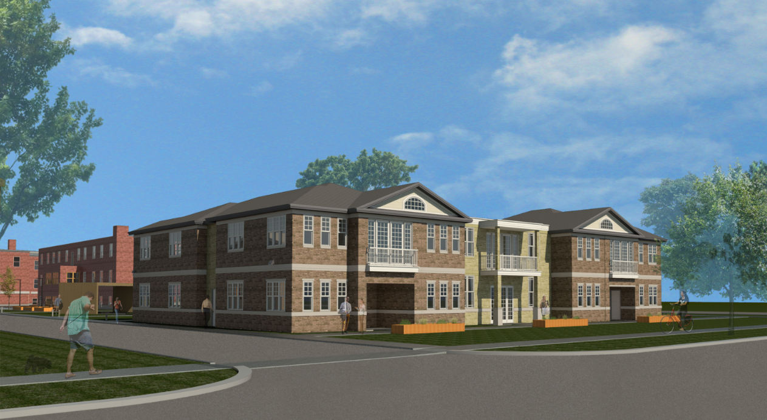

Slide 15
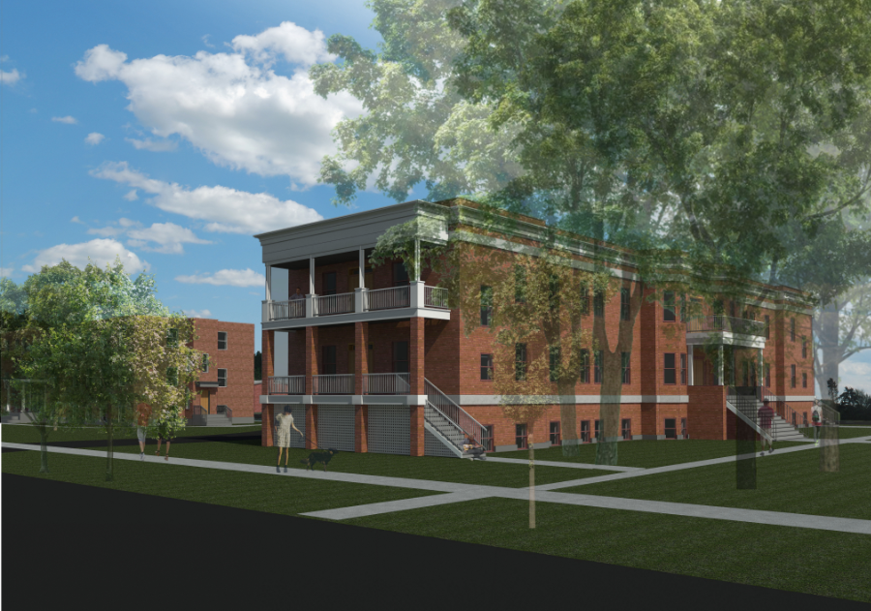
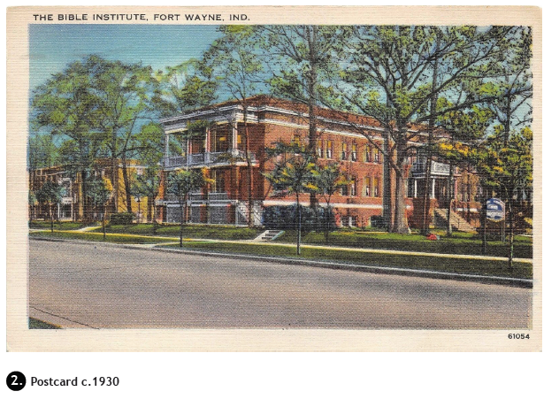

Slide 16
Requirements of Participation
Income Limits
60% of annual Area Median Income (based on household size and adjusted annually) at time of move-in. For 2015, these are:
1-person household: $25,950
2-person household: $29,700
3-person household: $33,375
Increasing income is encouraged and expected!
Increasing income will not affect any resident’s ability to continue living at the development.

Slide 17
Requirements of Participation
Rent Limits
Rents are limited based on tenant income and apartment size and are adjusted annually.
In 2015, the range would be $300 - $675.

Slide 18
Requirements of Participation
All prospective tenants must have:
Acceptable credit history;
Landlord reference;
Utility payment history;
Income verification;
Criminal background check.
Anyone with a felony conviction for violent, sexual, or child-related crimes will be excluded from residency.

Slide 19
Requirements of Participation
All tenants must:
Sign at least a one-year lease;
Work with Brightpoint staff to create and implement a business development action plan;
Make meaningful progress annually toward starting a business if they do not yet have one.

Slide 20
Business Development
The development will support business by:
Providing high-quality, affordable live/work space for entrepreneurs, business owners, and artists;
Providing business education courses on-site monthly and one-on-one assistance on-demand;
Providing a specialized loan product to residents to finance equipment, inventory, professional services, and working capital;
Reporting tenant rents to the credit bureaus to help them improve their credit and better access mainstream financial resources;
Working with other partners to offer a wide array of business development services.

Slide 21
Business Development
The development will support business by:
Working proactively with resident entrepreneurs to identify problems or help them grow their business;
Ensuring that each resident has a business development plan that identifies the assistance they may need or the milestones they must accomplish, and how that will happen;
Requiring that residents in pre-development stages of starting a business meet certain milestones and action steps within a certain amount of time.

Slide 22
Business Development
Brightpoint has had informal discussions with a number of local community organizations regarding shared programs and collocation of services for this development. Strategic partnerships are anticipated to include:
Indiana Tech Center for Creative Collaboration
The Wunderkammer Company
TekVenture
Arts United
Northeast Indiana Innovation Center

Slide 23
Funding
Total cost $7,973,112
$7,131,600 private equity from sale of tax credits
$685,000 conventional loan
$156,112 developer equity
Day-to-day operations supported by income from tenants’ rent payments

Slide 24
Timeline
August 27, 2015 – Tax credit award announced
Spring 2016 – Construction begins
Summer 2017 – Construction ends, leasing begins

Slide 25
Summary of Written Commitment
In order to limit the impacts on the surrounding and adjacent properties, Brightpoint is proposing a written commitment to limit the uses of the subject real estate.
The Written Commitment has been shared with the following Neighborhood Associations:
Oakdale Neighborhood Association
Southwood Park Community Association
Fairmont Neighborhood Association
Illsley Place Neighborhood Association
Foster Park Neighborhood Association
Southwest Area Partnership

Slide 26
Summary of Written Commitment
The Commitment attempts to define the types of businesses that will be permitted as part of the live-work concept:
The owner of the business must live in the unit;
No more than 50% of the unit can be devoted to business uses;
No more than 3 employees on site.
Recognizes classes of permitted uses:
Business services – professional, consulting, technology
Personal services – salons, health studio, music schools
Creative employment – painting, drawing, photography
Creation of functional art – furniture, rugs, jewelry
Other similar low intensity uses that do not create excessive noise, odors, or traffic

Slide 27
Summary of Written Commitment
The Commitment also specifically defines 111 uses that are not permitted on site. These are uses that would otherwise be permitted in the C-2 zoning district.
The list also incorporates prohibited uses based on feedback received from the various neighborhood meetings Brightpoint conducted.
The Commitment also imposes limits on building heights, outside storage, hours of operation, landscaping, signage, lighting, and outdoor parking.

Slide 28
Summary of Neighborhood Meetings
Neighborhood meetings were held on May 13th and May 27th at the Summit Campus.
Approximately 100 letters to surrounding property owners were mailed in advance of the May 13th meeting based on proximity to the subject real estate. Approximately 29 neighbors attended.
Approximately 3000 letters to surrounding property owners were mailed in advance of the May 27th meeting. Approximately 85 people attended.
In addition, the Brightpoint development team attended meetings of:
The Illsley Place Neighborhood Association
The Oakdale Neighborhood Association
The Southwest Area Partnership
The 46807 Quality of Life Steering Committee

Slide 29
Summary of Neighborhood Meetings
Some of the concerns raised at the neighborhood meetings included:
The distinction between a use variance and a rezoning;
The types of uses that would be permitted;
Whether the development would constitute subsidized or government supported housing;
The building materials and appearance of the new construction;
Qualifications for residency, including income, business requirements, and past criminal history.

Slide 30
Summary of Neighborhood Meetings
In response to the neighborhood meetings, Brightpoint has incorporated additional restrictions into the proposed written commitment and has revised the design and building materials of the proposed new construction.
Brightpoint has received letters of support from the 46807 Quality of Life Steering Committee and Mayor Henry.
The development has also received positive approval from the City’s Housing and Neighborhood Services (“HANDS”) Board

Slide 31
Development Issues
Site lighting will be limited as follows:
Parking lot lighting will be restricted to 15 feet in height and will utilize sharp cut off features to direct light downward and away from adjacent properties
Wall pack light fixtures will be mounted near doorways and other key places for safety and convenience and will utilize sharp cut off features
Low level bollard lighting will be utilized on walkways to provide and enhance safety
Signage will be limited to 8 feet in height and 50 square feet in area consistent with the requirements of the Zoning Ordinance.
Trash receptacles will be visually screened on 3 sides
Outdoor storage of inventory and equipment is prohibited

Slide 32
Development Issues
Delivery traffic and hours of operation will be limited to 8:00 a.m. to 8:00 p.m.
Buffering along the north property line will include a mix of landscape plantings and a solid wood privacy fence.
Overnight parking of business and inoperable vehicles will be prohibited, as will performing substantial maintenance or repairs to motor vehicles.
No new curb cuts to Rudisill Boulevard, Indiana Avenue, or South Wayne Street are contemplated as part of this project. Instead, all existing means of ingress and egress will be utilized.

Slide 33
Legal Test
The instant proposal meets the requirements stated in Ind. Code Section 36-7-4-603:
It is consistent with the Plan-It Allen Comprehensive Plan;
It is warranted by the current conditions and character of the surrounding uses and structures;
It is the most desirable use of the land;
It conserves the surrounding and adjoin property values; and
It satisfies the mandate for responsible growth and development.

Slide 34
Legal Test
The Guiding Principles at the outset of Plan-It Allen include the following pertinent recommendations:
“The visual character, historic features and natural assets within the community should be retained and enhanced.”
“Neighborhoods, downtowns, commercial centers and towns should be compact, pedestrian friendly and mixed use; districts of single use should be the exception.”
“Infill development and revitalization initiatives should be encouraged.”
“Housing with a diversity of values and types should be encouraged to provide housing choices within neighborhoods.”

Slide 35
Legal Test
Objective LU10 “encourage[s] sustainable growth by promoting quality, compatible infill development, revitalization and redevelopment in the Fort Wayne urban area.” Some of the key language of the Plan under this objective recognizes that:
“the cost of redeveloping land and rehabilitating or revitalizing buildings is not only driven by the cost of materials and labor, it is also influenced by the developer’s profit motive. In communities around the country, thousands of local . . . community-based organizations (CBOs) function as developers of residential and commercial property with no profit motive. As a result, these organizations are able to create viable, affordable projects by using public, private, and in-kind donations. These nonprofit organizations have developed significant expertise in development at the neighborhood or block level. They are often capable of putting together complex financial development transactions, involving many different financial sources, which few profit minded developers are willing to undertake.”
“Board members and staff of these nonprofits often live in the neighborhoods themselves, thereby ensuring that the activities that the organization seeks to complete help to achieve an improved quality of life for all residents of the neighborhood.”

Slide 36
Legal Test
Objective H3 contemplates that the community should “build on the assets and stabilize the existing neighborhoods.” In order to accomplish this objective, Plan-It Allen contemplates:
“By encouraging residential adaptive reuse through more flexible zoning regulations, jurisdictions can generate more housing, diversify housing stock, offer compatible mixed use opportunities, preserve historic character, and restore underutilized or deteriorating buildings to a useful purpose. Many different kinds of buildings can be converted to residential use, including old school buildings, hotels, hospitals, warehouses, and factories.”
“Architecturally compatible infill housing development provides communities with an alternative to continually growing outward . . .[I]nfill developments can often catalize revitalization in neglected cores. Infill housing development can lead to higher densities, better access to jobs through proximity to mass transit, greater affordability and more tax dollars for local government.”

Slide 37
Legal Test
Objective H4 includes promoting and providing housing choice within neighborhoods. On this point, Objective H4.C provides:
“encourage private builders to work in partnership with non-for-profit organizations to develop innovative housing designs that promote architectural diversity and affordability within neighborhoods. Private and not-for-profit housing developers can form partnerships to create new and rehabilitated housing developments and projects that contain both affordable and market-rate units, with both types of housing seamlessly meshed. Such partnerships can allow a project access to tax credits and support for federal and state housing funds, while creating more income-diverse and inclusive communities.”

Slide 38
Legal Test
This project represents the revitalization and re-use of historic structures that have long been dormant and under-utilized. Through a strategic investment and careful architectural planning, Brightpoint is restoring Schultz Hall, which was once slated for demolition during the Taylor era after a significant portion of the interior of the structure was devastated by fire.
This development also brings new buildings that have been designed and will be constructed using materials and architectural principles that pay homage to the historic character and fabric of the other buildings on the site and the homes within the surrounding area.
The development also brings diversity of housing, both in value and in type, to the Rudisill Boulevard corridor.

Slide 39
Legal Test
The development is within the growth area contemplated by the Plan-It Allen Conceptual Development Map and takes advantage of the fact that all utilities are already available at the site.
The development represents a collaboration of housing and working opportunities on site, thereby adhering to the Plan-It Allen’s goal of promoting mixed use developments with location of daily living activities within walking distance. The development will also include adequate common space where interaction and collaboration can occur among the residents and entrepreneurs.

Slide 40
Legal Test
Brightpoint is pooling together diverse resources – private investment, tax credit financing, traditional loan financing – as part of a complex financial development that few (if any) profit minded private developers have been willing to undertake since Taylor made the decision to close.
Brightpoint is responsive and accountable to community members in a way that few other entities are and is devoting substantial resources to the development, revitalization, and enhancement of a community oriented project. The Plan-It Allen Comprehensive Plan celebrates such innovative developments.
As recognized by Plan-It Allen, there is merit to having members of the development team live within the community to be served. In this case, two of Brightpoint’s own staff live within blocks of the project site. In addition, two of the architects for this project are also within blocks. As if the mission of Brightpoint were not motivation enough, the development team has a vested interest in improving the quality of life in the neighborhood.

Slide 41
Legal Test
This proposal will conserve, if not enhance, property values through a nearly $8 million investment in restoring long vacant and under utilized buildings.
In addition, in a recent survey on the effects of affordable housing on neighboring property values, the National Housing Conference’s Center for Housing Policy noted several concrete ways property values can be conserved:
Attractive design that blends well with the surrounding neighborhood is more likely to have no effect or even a positive effect on property values.
Poorly maintained housing has been shown to depress nearby property values.
Rehabilitation of distressed properties has proven beneficial to neighboring home values.

Slide 42
Questions and Comments

